Slide 1
ECG Signal
Acquisition and Analysis
Alex Margaris; 014575156
Socheath Sok; 014470701
Spring 2020 EE 407
Project 3

Slide 2
OVERVIEW
Introduction
BioRadio 150
Objective
Materials
Procedure
Results
References

Slide 3
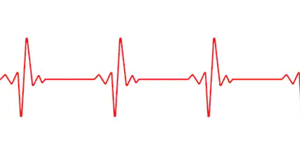
INTRODUCTION
Electrocardiography (ECG) captures the electrical activity of the heart over time
The cell membranes that form the outer covering of the heart cell have an associated charge which is depolarized during every heartbeat
These electrical signals are detected & amplified by the ECG
The change in beat to beat is called the heart rate variability (HRV)
Notes:
ECG CALCULATES THE HRV

Slide 4
INTRODUCTION
In many occasions of ECG recording, signal is corrupted by noise
Another physiological process of the body
Signal processing is performed in the vast majority of systems for ECG analysis and interpretation
Signal Processing results in:
Improvement of measurement accuracy and reproducibility
Extraction of information not readily available from the signal through visual assessment
Notes:
In many situations, the ECG is recorded during ambulatory or strenuous conditions such that the signal is corrupted by different types of noise, sometimes originating from another physiological process of the body.
This noise is very difficult to remove as it is in the same region as the actual signal.

Slide 5
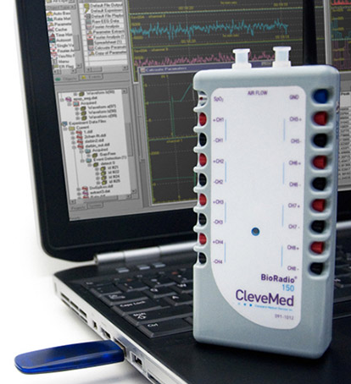
BIORADIO 150
The BioRadio 150 is a wireless biomedical monitor with programmable channels for recording and transmitting human physiological signals
ECG, EEG, & EMG
The BioCapture software is used to capture the data in flexible file format obtained via BioRadio
Notes:
but are not limited to, the Electroencephalogram (EEG), Electromyogram (EMG) and Electrocardiogram (ECG).
BioRadio is used to record the signals.
BioCapture is a software used for data collection and analysis

Slide 6
OBJECTIVE
To collect physiological data
To record the waveform
To analyze the waveform

Slide 7
MATERIALS
BioRadio 150
Electrodes
Electrodes connector
USB Receiver
BIomedical Toolkit

Slide 8
PROCEDURE
Attach the electrodes onto the subject and electrode connectors onto the BioRadio 150
Connect BioRadio to the computer and use BioCapture software to record waveforms
Save the waveform as csv file for analyzing using Biomedical Toolkit

Slide 9
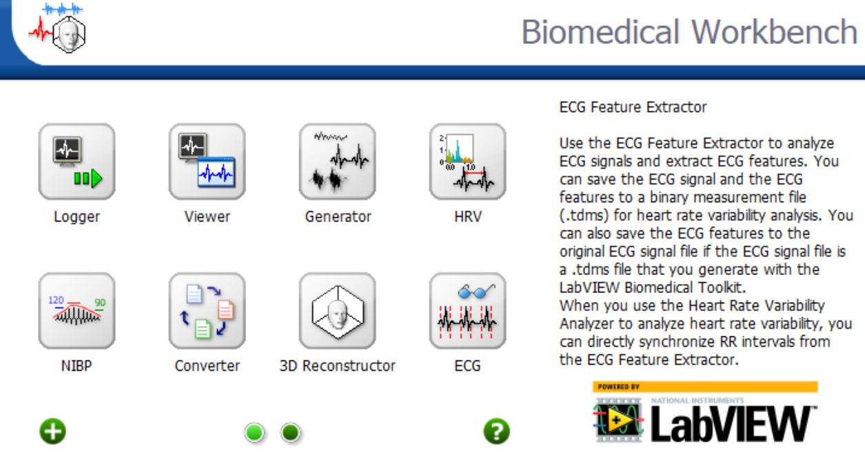
Biomedical Toolkit
A collection of ready-to-run applications, utilities, and algorithms
Designed to simplify the use of LabVIEW software
Focus on:
Data Acquisition
Signal Processing
Image Processing
Notes:
It is specifically used for the ECG feature extractor to analyze the ECG signals and extract the features.
This is essential to our experiemtn bc it focuses on

Slide 10
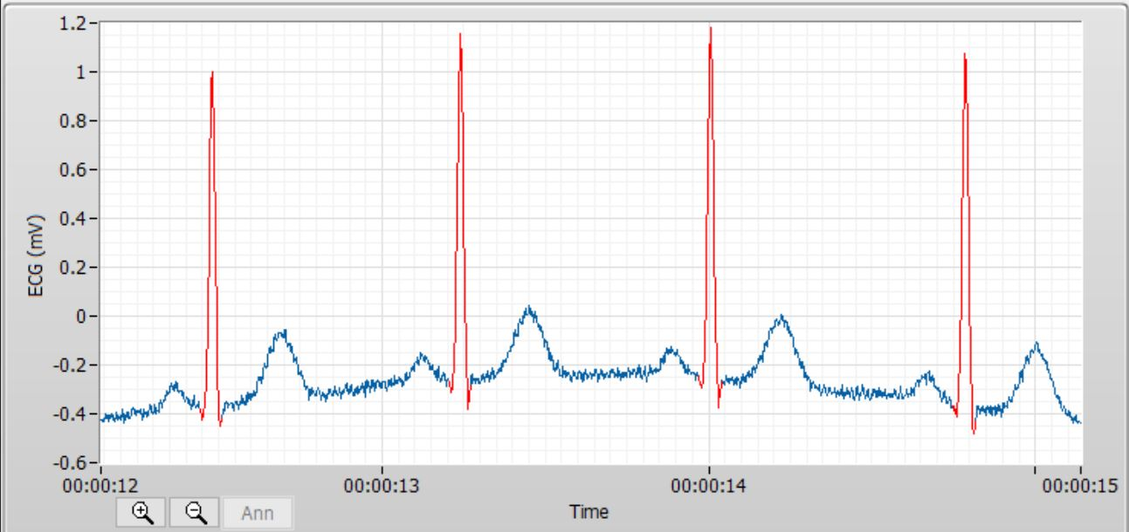
Signal Acquisition
Obtained using ECG feature extractor
Settings
QRS detection
P / T refinement
Bandpass filter
Rectification
Notes:
Rectification: converts alternating current (AC), which periodically reverses direction, to direct current (DC), which flows in only one direction.
Left at default

Slide 11
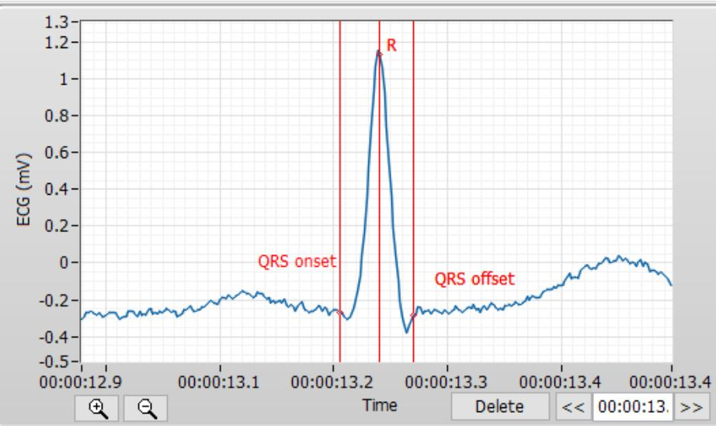
QRS Complex
Represents the electrical impulse as it spreads through the ventricles
Indicate ventricular depolarization
Often used to determine the axis of the electrocardiogram
Amplitude mean: 1.5 mV
Amplitude std. : 0.031 mV
Width mean: 87 ms
Width std: 2ms
Notes:
A “wide QRS complex” refers to a QRS complex duration ≥120 ms. Widening of the QRS complex is related to slower spread of ventricular depolarization.
Normal duration of qrs: 80 to 100 ms

Slide 12
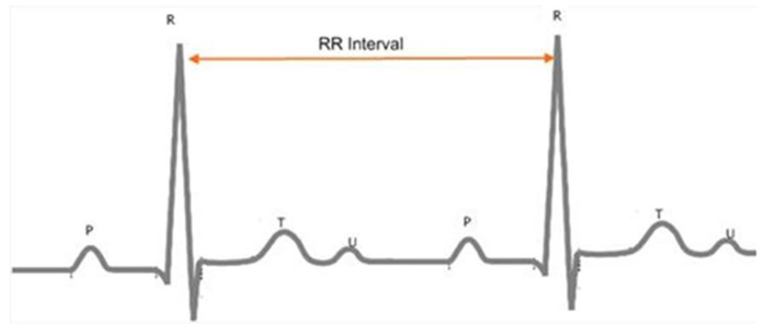
Heart Rate Variability Analysis
Methods:
Time-domain analysis
Extracts measurements from R-R interval signals
Show changes in autonomic nervous system (ANS)
Ex: mean and std of all heat rates
Spectral analysis
Extracts frequency-domain parameters from R-R interval signals
Peak frequency and Power
Can be used to monitor ANS
Ex: FFT spectrum
Notes:
The autonomic system is the part of the peripheral nervous system that is responsible for regulating involuntary body functions, such as heartbeat, blood flow, breathing, and digestion

Slide 13
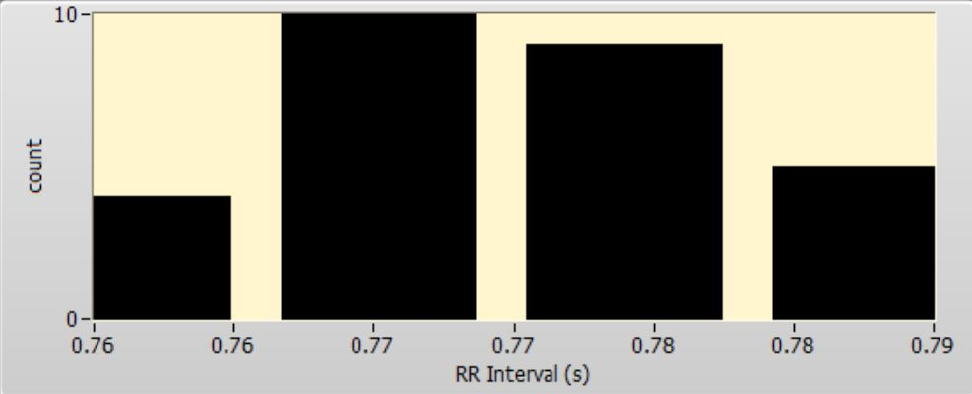
Histogram of R-R Intervals
Mean: 769 ms
Normal interval: 0.6 to 1.2 sec
Std: 8 ms
RMSSD: 37 ms
Root Mean Square of the Successive Differences
most relevant and accurate measure of ANS activity over the short-term
HRV Triangular index: 10.5
integral of the density of the RR interval histogram divided by its height
For RMSSD ≤ 0.068s, the heart rhythm is
HTI ≤ 20.42 → normal heart rhythm
HTI > 20.42 → arrhythmia
Notes:
HTI and RMSSD can jointly distinguish between normal heart rhythms and arrhythmias.
Normal range: 18 to 87 ms for ages 20 to 30

Slide 14
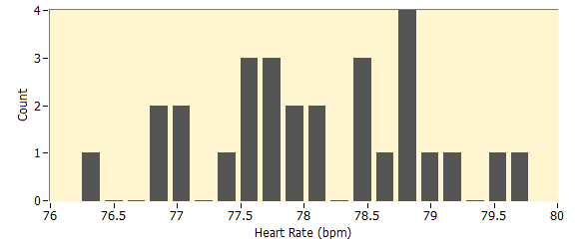
Heart Rate Histogram
Show how often each heart rate occur
Total # of beats: 33
Heart rate mean: 78 bpm
Heart Rate std.: 0.89 bpm
Heart rate can be used to determine the condition of the heart
Normal ( 60 to 100 BPM)
Bradycardia (<40 BPM)
Tachycardia (>100 BPM)
Notes:
The heart is an organ that circulate oxygen and nutrient-rich blood throughout the body. When it's not working properly, just about everything is affected

Slide 15
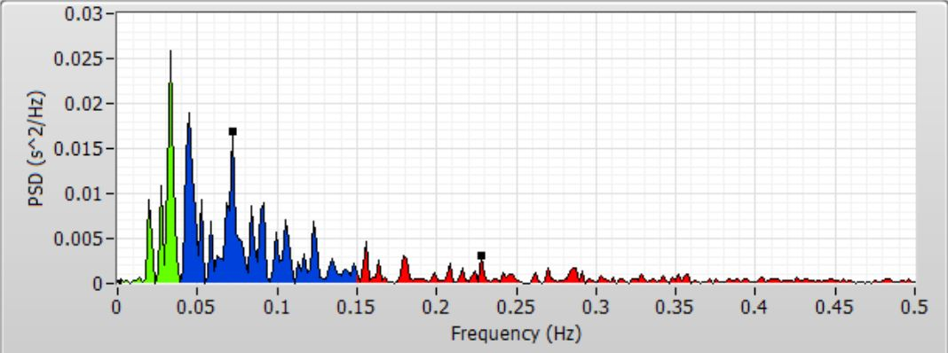
FFT Spectrum of RR Interval
VHL power: 140 ms^2
18%
Range: 0 Hz to 0.04 Hz
LF power: 470 ms^2
60%
Range: 0.04 Hz to 0.15 Hz
HF power: 171 ms^@
22%
Range: 0.15 Hz to 0.5 Hz
Problems with using FFT analysis:
Requires stationary data segments
Often need artificial interpolation which would introduce biases
Notes:
FFT provides frequency information about the signal.
VLH: not well characterized, but is speculated to reflect circadian inputs to the heart
LF: reflects the combined responses of the heart to both vagal and sympathetic stimulation
HF: reflects the RSA(respiratory sinus arrhythmia) and is mediated solely by the Vagus nerve and typically occurs at the rate of respiration

Slide 16
References
[1] “The BioRadio Wireless Physiology Monitor.” The BioRadio Wireless Physiology Monitor |,
[2] Bharadwaj, Ajay, et al. “Techniques for Accurate ECG Signal Processing.” EETimes, EE Times, 14 Feb. 2011, https://www.eetimes.com/document.asp?doc_id=1278571.
[3] “BioCapture : Acquiring ECG Data.” Http://Glneurotech.com/Bioradio/Wp-Content/Uploads/2014/08/Note_BioCapture-ECG.pdf

